Slide 1
Data Association and Outlier Rejection Techniques for SLAM
Chi Hay Tong | CRV 2010 SLAM Camp
May 27, 2010
Notes:
Chi Hay Tong, PhD Student under Prof. Tim Barfoot in the Autonomous Space Robotics Lab at the University of Toronto Institute for Aerospace Studies

Slide 2
Outline
Introduction
Data Association Techniques
Feature Descriptors
Descriptor-Free Methods
Outlier Rejection
Summary
Open Problems
Notes:
I will begin with an introduction to SLAM, and in particular, the data association problem
Intent is to introduce you to some of the problems to consider, algorithms out there, provide the intuition without getting bogged down in the math – and to point you in the right direction to get more information
Cover some of the methods for data association – the simple, established ones – there are much more complex methods than what I’m going to present
Talk about the parallel problem – outlier rejection – if data association seeks to get the right associations, outlier rejection seeks to detect mistakes and remove them
Summarize it all, talk about what is working so far
Then, talk a bit about the open problems, avenues for research, and a bit about what I’m interested in and have been working on

Slide 3
Outline
Introduction
Data Association Techniques
Feature Descriptors
Descriptor-Free Methods
Outlier Rejection
Summary
Open Problems
Notes:
Beginning with an introduction to the problem

Slide 4
Introduction | SLAM Example
Chi Hay Tong
CRV 2010 SLAM Camp: Outlier Rejection Tutorial
Notes:
Start by talking about the Simultaneous Localization and Mapping (SLAM) problem
In particular, robotic mapping – and to introduce the data association problem
We have a robot traversing in a scene, and at each stop, it make some observations to some landmarks
We choose the point feature representation of the terrain, because it is easier to illustrate (distinctive points)
Taking all of these measurements, we would like to figure out where the robot travelled, and where the landmarks are (the map)
A good approach would be to figure out which landmarks are which, so that we can identify if we’ve returned to a place we’ve been before (loop closure)
4

Slide 5
Introduction | Data Association Problem
How do we identify the landmarks?
State-space measurement model:
2
1
3
6
4
5
Estimated rover pose and map
Feature measurements
Notes:
The data association problem – how do we figure out which features we’ve found in our current scan correspond to which features we’ve seen before?
In our measurement model – we’re measuring to the ith landmark – how did we figure out it was landmark i
Illustrate this with an example – say we have an estimated rover pose and a map of the terrain (with landmarks indexed), and we get some measurements
For each measurement, how do we know which landmark we’re looking at? Or even – what if it is spurious (doesn’t match anything?)
Many of my examples will consider localizing to a known map, but in most cases, extending it to SLAM is trivial – you just introduce unmatched features as new features – usually with a minimum spacing heuristic to make sure matching isn’t too difficult

Slide 6
Outline
Introduction
Data Association Techniques
Feature Descriptors
Descriptor-Free Methods
Outlier Rejection
Summary
Open Problems
Notes:
Let’s talk about some of the methods in literature regarding how we can address this problem
We begin with talking about feature descriptors

Slide 7
Feature Descriptors | Image Feature Example
Notes:
Starting with camera imagery, we have this scene of natural terrain

Slide 8
Feature Descriptors | Image Feature Example
Notes:
We can identify interesting points in the image to serve as our landmarks – in this case, we use SURF
For each of these interest points, we will attempt to uniquely describe them for data association

Slide 9
Feature Descriptors | Image Feature Descriptors
Some algorithms:
Scale Invariant Feature Transform (SIFT) [Lowe, 2004]
Speeded Up Robust Features (SURF) [Bay et al., 2006]
Notes:
Feature descriptors are ways to describe an interest point using a mathematical signature
If unique, these can be matched and provide the data associations required
Since this is automated, mistakes will be make, but it can be corrected, as will be explained in the section on outlier rejection
Won’t go into too much detail on this because I’m sure there are much more qualified people in this room to explain the different varieties available

Slide 10
Feature Descriptors | Point Cloud Features
Spin Images [Johnson, 1997]
Point Fingerprints [Sun et al., 2003]
Local Shape Descriptors [Taati et al., 2007]
Figures: (a) Vertex-based Spin Image, (b) Point Fingerprint Extraction.
Sources: [Johnson,1997] [Bakambu et al., 2006]
Notes:
Some options also exist for laser data, but it’s much less refined
Point clouds are much more sparse than the richness of camera data, so a number of issues arise that make it not that useful
Primarily – occlusion, and non-uniform resolution which is of a big issue when we’re talking about large viewpoint changes (which often occurs due to the lower sampling rate)

Slide 11
Feature Descriptors | Descriptor Limitations
Notes:
Large viewpoint change not only doesn’t give us similar data to match, but occlusion leads to missing data in the descriptor

Slide 12
Outline
Introduction
Data Association Techniques
Feature Descriptors
Descriptor-Free Methods
Outlier Rejection
Summary
Open Problems
Notes:
Other options are to use a descriptor-free method – rather use the geometric properties of the landmarks

Slide 13
Descriptor-Free | Nearest Neighbour
Associate to the landmark closest in distance
2
1
3
4
6
5
Estimated rover pose and map
Feature measurements
Notes:
- We consider each measurement independently, and for each measurement, we associate to the closest in distance based on our current estimate

Slide 14
Descriptor-Free | Validation Gating
Validation Gating [Bar-Shalom and Fortmann, 1988]
2
1
3
4
6
5
Notes:
What if we had a spurious feature? We shouldn’t try to associate everything
From target-tracking literature, we use the noise properties of the measurement to have a bounds on the nearest-neighbour distance
Create a “gate” to for valid associations only

Slide 15
Descriptor-Free | NIS Gating
Normalized Innovation Squared [Bar-Shalom et al., 2002]
2
1
3
4
6
5
Notes:
What if we weren’t that confident with our estimate of the pose?
We would have an uncertainty to it
And if that were true, then the robot could also possibly be here
The NIS test incorporates the uncertainty in the estimate of the pose, map, and measurement to appropriately inflate the gating threshold
But in inflating, we also end up with more viable associations – how do we resolve this ambiguity?

Slide 16
Descriptor-Free | Batch Associations
2
1
3
4
6
5
Estimated rover pose and map
Feature measurements
Notes:
How can we do better than this?
Let’s use more measurements at the same time

Slide 17
Descriptor-Free | JCBB
Joint Compatibility Branch and Bound
[Neira and Tardos, 2001]
2
i
(i,5)
(i,6)
1
3
ii
(ii,4)
iii
(iii,1)
4
6
5
Notes:
Continuing from our NIS example, we see that we have two possible associations, where one requires the robot to be on the right, and the other on the left (both possible because of the uncertainty in the rover position) – illustrate with a tree
Let’s take one of them – if this is the case, then we get a lot more certain about the rover position – only way for the association to be valid
Now, considering the next measurement, we see that there’s no valid assignments for it
However, if we consider the other possibility, we get two associations that are jointly compatible – this further reduces our possible rover locations, and we assign more, and so forth
In JCBB, each possible association is expanded, and an additional measurement is considered each time – this is formulated as an interpretation tree, with each level corresponding to an association, backtracking if necessary

Slide 18
Descriptor-Free | CCDA
Combined Constraint Data Association [Bailey, 2002]
2
(i,6)
1
(i,5)
3
(ii,4)
4
(iii,1)
(iii,3)
6
5
Notes:
Different approach, same idea – using a graph instead of a tree
Using the NIS gating, we’ll consider the three measurements from before, and all possible associations
Mark them as nodes in a graph, and then we consider all the pairs of associations (obviously two measurements can’t be of the same landmark)
Mark valid ones as edges, and then we find the maximum common subgraph
This is reportedly more efficient than JCBB because we have efficient graph algorithms at our disposal

Slide 19
Descriptor-Free | DARCES
Data-Aligned Rigidity-Constrained Exhaustive Search [Chen et al., 1999]
2
1
3
4
6
5
Estimated rover pose and map
Feature measurements
Notes:
Created for 3D alignment of range images
Idea is to match similar triangles from the scan to the scene – We don’t require an estimate for the rover pose
Pick 3 measurements, and label them primary, secondary, auxiliary
Starting with the primary, we assign it to a point in the scene, then we consider the distance between the primary and secondary, conducting a shell search (thickness appropriately sized based on the uncertainty in the measurement and map) for all possible secondaries, then for all secondaries, we consider the distance to the auxillary, and back to the primary – if all three shell searches pass, we have a hypothesis
This is exhaustive because we do it for all sets of three – and a lot of hypotheses get generated due to the shell thicknesses – a method to evaluate which is the best is required

Slide 20
Outline
Introduction
Data Association Techniques
Feature Descriptors
Descriptor-Free Methods
Outlier Rejection
Summary
Open Problems
Notes:
Using automated methods in data association will inevitably have mistakes
I’ll talk about the parallel problem of outlier rejection (robust estimation), which seeks to clean the incorrect associations

Slide 21
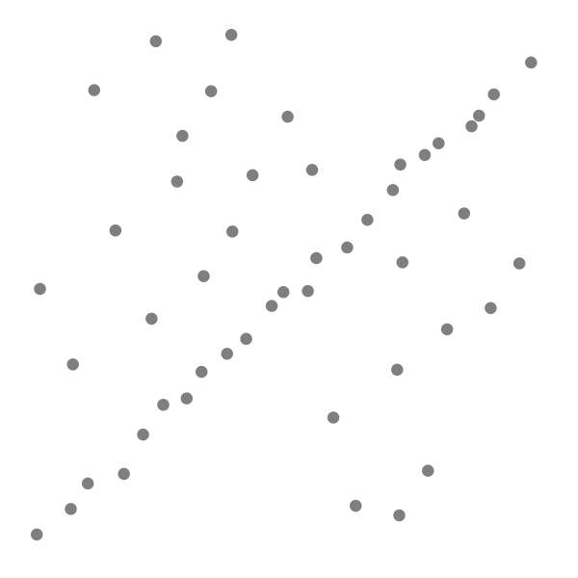
Outlier Rejection | Introduction
Outliers are defined as measurements that do not fit the measurement model
In robotics:
Catastrophic wheel slippage
Incorrect data associations
Spurious features
Sensor error
Notes:
Once again, we look at our measurement model
If we get the association wrong, then our measurements should be outliers
We must handle them appropriately – for illustration, let’s look at the line-of-best-fit problem
Similar to SLAM, we’re seeking to find the hidden true model given noisy data

Slide 22
Outlier Rejection | RANSAC
RANdom SAmple and Consensus
[Fischler and Bolles, 1981]
Assumptions:
Inliers fit some underlying noisy distribution model
Outliers do not fit the same model
Concept:
The inliers should provide a consensus about the true model
Notes:
- Predominant method of outlier rejection due to its considerable performance

Slide 23
Outlier Rejection | RANSAC Example
Notes:
Try out some models supported by the data, find the model that has the most support
Randomly pick two points – the minimum number to construct a model
Compute a model based on this minimal set, and see what other measurements agree with it
Repeat a number of times (based on the corruption percentage), and pick the largest consensus set
Because it is random, it is possible for us to pick a bad initial set, but that’s okay

Slide 24
Outlier Rejection | RANSAC Iterations
How do we get a good test model?
Construct a set with only inliers
How many iterations do we need?
Minimal set of N measurements
N Bernoulli trials with a probability p of picking an outlier
Notes:
We need good test models to find the largest consensus set
We expect good models if we use only inliers to construct it
So how many iterations to ensure we’ve started with a set of only inliers?
50% corruption, that’s only 12 times for the line-of-best-fit, and 24 times for pairwise image alignment
Reality is more, but it’s pretty powerful

Slide 25
Outline
Introduction
Data Association Techniques
Feature Descriptors
Descriptor-Free Methods
Outlier Rejection
Summary
Open Problems
Notes:
Let’s provide a bit of a summary of what we’ve talked about

Slide 26
Summary
Data Association
Feature descriptors
NN, Validation Gating, NIS
JCBB, CCDA, DARCES
Outlier Rejection
RANSAC
Topics not covered:
Multihypothesis Data Association
Lazy data association
M-estimation
Notes:
Also here are some topics that I didn’t cover, but should probably be looked into if you’re interested in the area
In reality however, the most effective is RANSAC and M-estimation using camera-based systems because feature descriptors work really well
Impressive results in Visual Odometry, as I’m sure will be talked about

Slide 27
Outline
Introduction
Data Association Techniques
Feature Descriptors
Descriptor-Free Methods
Outlier Rejection
Summary
Open Problems
Notes:
Let’s chat briefly about the open problems

Slide 28
Open Problems
3D, unstructured environments
Interest point detection and matching
Sparsity of features
Batch alignment
Higher dimensionality
Differing sensor types
Laser data
Odometry
Periodic localization updates
Notes:
3D and unstructured environments are more difficult – hard to pick out what is interesting and a good unique way to describe it for feature descriptors
Batch/sliding window is better than the frame-to-frame approach – but right now, data association and outlier detection is still conducted frame-to-frame
New sensors – lasers for permanently shadowed areas, odometry measurements, localization from satellites – all can have outliers – can we also perform outlier rejection on them?

Slide 29
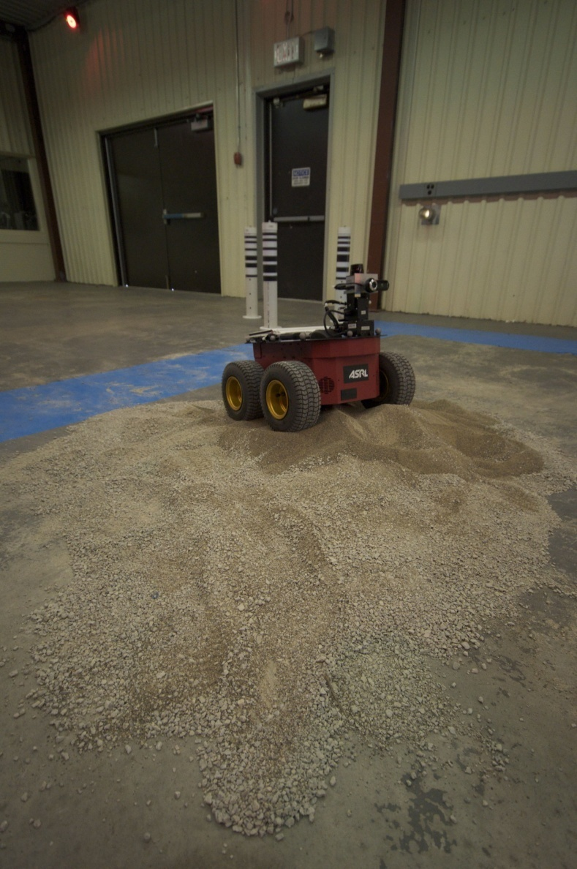
Open Problems | Heterogeneous Outliers in Batch SLAM
Notes:
Conclude with an example of the problem of outliers in real data – this is some data gathered in our lab at the University of Toronto
Indoor rover mounted with a laser rangefinder to obtain 3D scans, observing these barcoded landmarks
Introduced sand to encourage wheel slippage, random misassociations for feature outliers

Slide 30
Open Problems | Dead Reckoning
Notes:
Using the wheel odometry alone, we get a poor estimate
Scans are the different colours
So we use a sensor fusion method, SLAM

Slide 31
Open Problems | Batch Alignment (Flyby)
Notes:
Still no good – outliers cause really poor mapping – brown, pink, light blue
Note how the walls and floor don’t line up

Slide 32
Open Problems | Batch Outlier Rejection (Flyby)
Notes:
If we were able to detect and remove the outliers, then we would do a lot better
How? This is a problem I’m working on

Slide 33
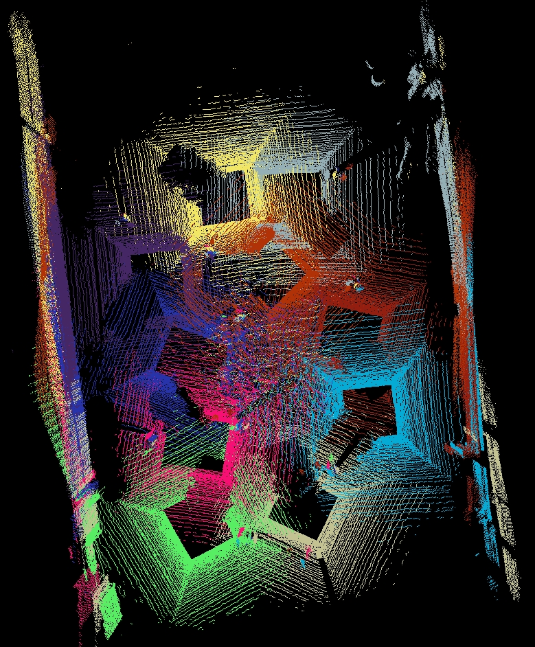
Questions?
Contact Information
Chi Hay Tong
http://asrl.utias.utoronto.ca/~cht/
chihay.tong@utoronto.ca

Slide 34
References | Feature Descriptors
[Lowe, 2004]
D. G. Lowe. Distinctive Image Features from Scale-Invariant Keypoints. International Journal of Computer Vision, 60, 2, pp. 91-110, 2004.
[Bay et al., 2006]
H. Bay, A. Ess, T. Tuytelaars, L. Van Gool. SURF: Speeded Up Robust Features. Computer Vision and Image Understanding (CVIU), Vol. 110, No. 3, pp. 346--359, 2008
[Johnson, 1997]
A. Johnson. Spin Images: A representation for 3-D surface matching. PhD thesis, August 1997.
[Sun et al., 2003]
Y. Sun, J. Paik, A. Koschan, D. Page, and M. Abidi. Point Fingerprint: A new 2-D object representation scheme. IEEE Transactions On Systems, Man, And Cybernetics, 2003.
[Taati et al., 2007]
B. Taati, M. Bondy, P. Jasiobedzki, and M. Greenspan. Variable dimensional local shape descriptors for object recognition in range data. In IEEE Internation Conference on Computer Vision, 2007.
[Bakambu et al., 2006]
J.N. Bakambu, S. Gemme, and E. Dupuis. Rover localization through 3D terrain registration in natural environments. In Proc. IEEE/RSJ International Conference on Intelligent Robots and Systems, 2006.

Slide 35
References | Descriptor-Free Methods
[Bar-Shalom and Fortmann, 1988]
Y. Bar-Shalom and T.E. Fortmann. Tracking and Data Association. New York: Academic Press, 1988.
[Bar-Shalom et al., 2002]
Y. Bar-Shalom, T. Kirubarajan, and X. Li. Estimation with Applications to Tracking and Navigation. John Wiley & Sons, Inc., 2002.
[Chen et al., 1999]
C. Chen, H. Hung, and J. Cheng. RANSAC-based DARCES: A new approach to fast automatic registration of partially overlapping range images. IEEE Transactions on Pattern Analysis and Machine Intelligence, 21:1229–1234, 1999.
[Neira and Tardos, 2001]
J. Neira and J.D. Tardos. Data association in stochastic mapping using the joint compatibility test. Robotics and Automation, IEEE Transactions on, 17(6):890–897, Dec 2001. ISSN 1042-296X.
[Bailey, 2002]
T. Bailey. Mobile Robot Localisation and Mapping in Extensive Outdoor Environments. PhD thesis, Australian Centre for Field Robotics, University of Sydney, 2002.

Slide 36
References | Outlier Rejection
[Fischler and Bolles, 1981]
M.A. Fischler and R.C. Bolles. Random sample consensus: a paradigm for model fitting with applications to image analysis and automated cartography. Commun. ACM, 24(6):381–395, 1981.
[Zhang, 1997]
Z. Zhang. Parameter estimation techniques: A tutorial with application to conic fitting. Image and Vision Computing Journal, 15, 1997.

